Slide 1

Breast cancer Detection using
Deep Learning

Slide 2


PROJECT GUIDE:
Mrs. Sugavaneshwari P
TEAM MEMBERS:
Abinaya T - 613519104002
Harni S - 613519104020
Mahalakshmi R - 613519104025
Shivaranjani N - 613519104037

Slide 3
OBJECTIVE
Breast cancer is one of the significant causes of the mortality among women.
The objective of breast cancer detection using CNN (Convolutional Neural Networks) is to develop a machine learning model that can accurately classify mammogram images as either benign or malignant. Thus, the results show that it has higher accuracy than other existing methods

Slide 4

EXISTING SYSTEM
Mammography is the most widely used method for breast cancer detection . It involves taking X-ray images of the breast and analyzing them for any abnormalities.
Computer-aided detection (CAD) systems can be used to assist radiologists in detecting abnormalities in mammograms
Disadvantages
False positives and false negatives
Low Accuracy
Limited sensitivity
Inefficiency in Dense Breast Tissue

Slide 5
PROPOSED SOLUTION
We propose a method for the classification of breast mammogrammic images using Convolutional Neural Networks (CNNs). Our method classifies images into three categories: Normal , Begnin , Maliganant .
Our method achieves an accuracy of 82.8% for the Three-class classification and demonstrates a accuracy of 95.6% for cancer cases.
Advantages
High Accuracy
Early Detection
Quality assurance
Improved Health Care
Better Patient Outcomes

Slide 6
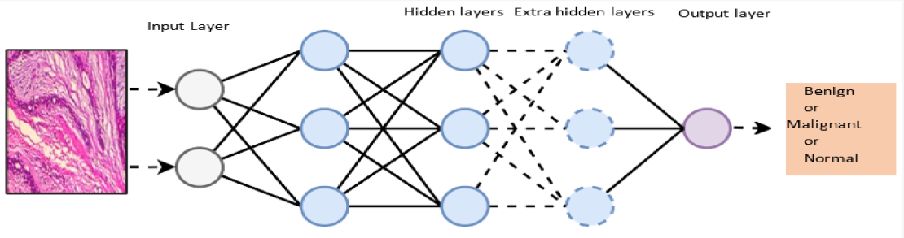
Conventional Neural Network

Slide 7
WORKFLOW DIAGRAM
Data Preprocessing
Dataset
Cleaning
Feature Selection
Transformation
Test Data
Training Data
Model Generation
Generating Report
Prediction of Cancer
Implementing CNN
Patient New Data

Slide 8
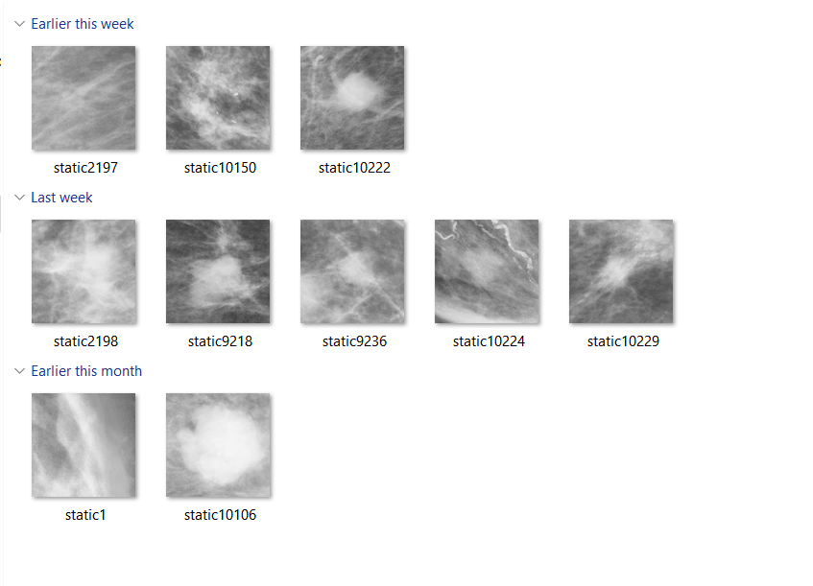
Datasets

Slide 9

SYSTEM REQUIREMENTS
HARDWARE REQUIREMENTS
Processor : Intel, AMD, Ryzen
Installed memory (RAM) : 4 GB or above
Hard Disk : 100 GB or above
Operating System : Windows 7,8,10,11 - 64 bit
SOFTWARE REQUIREMENTS
Software : Pycharm / Google collab / Visual studio code
Language : Python , HTML & CSS , JS

Slide 10

Screenshots

Slide 11

Screenshots

Slide 12
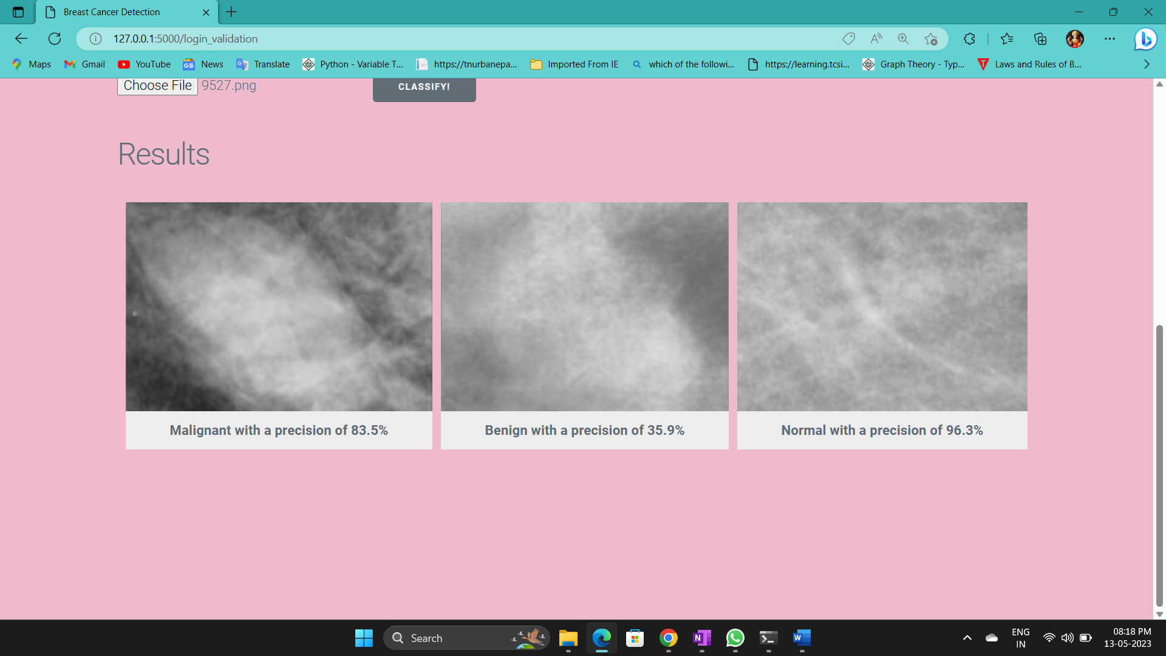
Screenshots

Slide 13
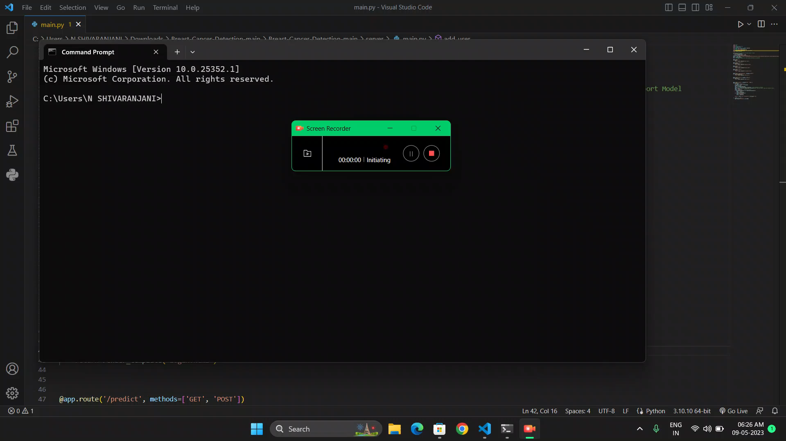
Demo(Video)

Slide 14
TIMELINE
Month of | Task | Status
February | Title | Completed
 | Base paper collection | Completed
 | Study of Chosen reference paper | Completed
 | Collecting Dataset | Completed
 | Working of dataset | Completed
March | Data Pre processing | Completed
 | Login/Register | Completed
 | Feature extraction | Completed
April | Classifier Web page | Completed
 | Breast Cancer detection and classification of cancer is identified | Completed

Slide 15
REFERENCES
N. Khuriwal and N. Mishra, "Breast Cancer Detection From Histopathological Images Using Deep Learning," 2018 3rd International Conference and Workshops on Recent Advances and Innovations in Engineering (ICRAIE), Jaipur, India, 2018, pp. 1-4, doi: 10.1109/ICRAIE.2018.8710426.
T. Reimer and S. Pistorius, "The Diagnostic Performance of Machine Learning in Breast Microwave Sensing on an Experimental Dataset," in IEEE Journal of Electromagnetics, RF and Microwaves in Medicine and Biology, vol. 6, no. 1, pp. 139-145, March 2022, doi: 10.1109/JERM.2021.3076100.
D. M. Vo, N. Q. Nguyen, and S. W. Lee, “Classification of breast cancer histology images using incremental boosting convolution networks,” Inf. Sci. (Ny)., vol. 482, pp. 123–138, 2019.
H. Chougrad, H. Zouaki, and O. Alheyane, “Deep Convolutional Neural Networks for breast cancer screening,” Comput. Methods Programs Biomed., vol.157,pp.19–30,2018.
Z. Wang et al., "Breast Cancer Detection Using Extreme Learning Machine Based on Feature Fusion With CNN Deep Features," in IEEE Access, vol. 7, pp. 105146-105158, 2019, doi: 10.1109/ACCESS.2019.2892795.

Slide 16
THANK YOU

